Slide 1
Wireless Sensor Network (WSN)

Slide 2


Overview of WSN
Administrator
Wireless sensor networks (WSNs) is a self-configured and infrastructure-less wireless network (like MANET) consists of a large number of sensor nodes to monitor physical or environmental conditions of sensor field.
A sensor node consists of sensing (measuring), computing (calculate any change in value of sensor output in digital form) and communication elements.
The acquired data or information by the sensing nodes is passed through the network to a sink (location where administrators monitor and analyze data).
Internet
Base Station
Sensor Field
Fig.1 Basic of WSN

Slide 3
For example a sensing node can sense the environment like:
Physical world (temperature, pressure, sound level, wind direction and speed, illumination intensity)
Biological system (biological and chemical sensors for national security applications for example Air pollution monitoring, Water quality monitoring)

Slide 4
Applications
A wide-range of applications offered by WSN, some of these are environmental monitoring, industrial sensing, infrastructure protection, battlefield awareness and temperature sensing.
A short list of applications follows.
Military applications
Monitoring inimical forces
Monitoring friendly forces and equipment
Military-theater or battlefield surveillance
Targeting
Battle damage assessment
Nuclear, biological, and chemical attack detection
and more . . .

Slide 5
Environmental applications
Microclimates
Forest fire detection
Flood detection
Precision agriculture
and more . . .
Health applications
Remote monitoring of physiological data
Tracking and monitoring doctors and patients inside a hospital
Drug administration
Elderly assistance
and more . . .

Slide 6
Home applications
Home automation
Instrumented environment
Automated meter reading
and more . . .
Commercial applications
Environmental control in industrial and office buildings
Vehicle tracking and detection
Traffic flow surveillance
and more . . .

Slide 7
Components of a sensor node
Figure 2 shows a typical sensor node. A node consists mainly of 3 components: sensing unit, a processing unit, self-power unit and communication unit.
Self-Power
Sensing
Sensing unit
Processing unit
Memory
Sensor
ADC
Self and remote testing
Sync and Timing
Transmitter/Receiver
Routing Table
Security unit
Array of sensor
Fig.2 A typical wireless sensor node
A Sensor node in WSNs have limited memory, processing capacity, battery power to serve the network.

Slide 8
Sensing Unit
The sensing unit consists of a sensor and an analog-to-digital converter. A smart sensor node consists of a combination of multiple sensors like MIMO.
The analog signals produced by the sensors, based on the observed event, are converted to digital signals by the converter and then fed into the processing unit.
Sensing
Sensor
ADC
Processing and Memory Unit
The processing unit (associated with memory) performs certain computations on the data depending on how it is programmed, may send the resulting information out to the network.
The processor determines what data needs to be analyzed, stored, or compared with the data stored in memory.

Slide 9
Self-Power Unit
A sensor node is supposed to be mounted in a small physical unit, limiting space for the battery. Moreover, the random distribution of sensors makes it impossible to periodically recharge or exchange batteries.
In WSN, the power unit in a sensor node is the most important unit because the liveliness and existence of a node depend on the energy left in the node, and the routing in the sensor network is based on the algorithm that finds a path with the least energy.
Thus, it is essential to use energy-efficient algorithms to prolong the life of sensor networks. The main task of the sensor node is to identify events, to process data, and then to transmit the data. The power of a node is consumed mainly in the transmitter and receiver unit.
The sensor node can be supplied by a self-power unit battery, or solar cells. However, a solar cell may not be the best choice as a power supply, owing to its weight, volume, and expense. In some application scenarios, sensor-node lifetime depends on the battery lifetime.

Slide 10
1) Power Constraints:
A sensor node is designed to be small and lightweight, which restricts the size and capacity of the battery.
Since nodes are often deployed in remote or inaccessible areas, it is usually impractical to recharge or replace batteries.
2) Importance of Power Management:
The lifetime of a node and, ultimately, the lifetime of the entire network, depends on the available energy.
Most WSN routing protocols and algorithms focus on energy efficiency, often choosing communication paths that minimize overall energy consumption.
3) Energy Consumption Factors:
The major energy-draining components in a sensor node are:
Transmitter unit: Sending data packets consumes high energy.
Receiver unit: Listening for or receiving data also requires significant energy.
Event detection and data processing consume comparatively less energy.

Slide 11
4) Power Supply Options:
Battery-powered:
Common in many WSN applications.
Lifetime of the node is directly tied to battery life.
5) Solar cells (energy harvesting):
Provide renewable power, potentially extending network lifetime.
However, they are often bulky, expensive, and unsuitable in certain environments (e.g., underground, underwater, dense forests).
6) Design Challenge:
The trade-off between node functionality, battery capacity, and physical size must be carefully managed.
To prolong network lifetime, energy-aware protocols (such as clustering, duty cycling, or data aggregation) are essential.

Slide 12
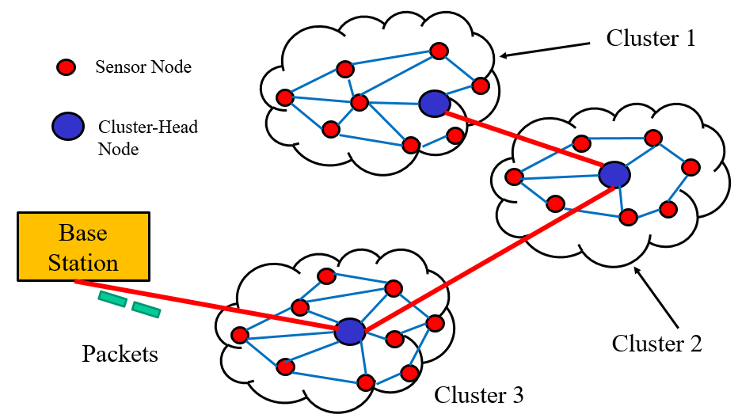
Infrastructure of Sensor Networks
Sensor nodes in the vicinity of a certain predefined region, forms a cluster. Each cluster contains a cluster head responsible for collecting and routing data from its nodes to a base station.

Slide 13
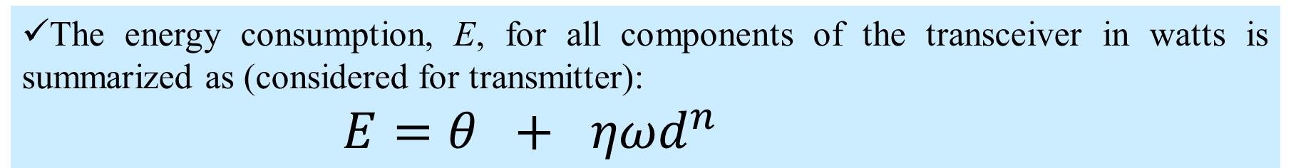
Communication Energy Model
In WSN, data transmission consumes more energy than data sensing and processing, therefore energy saving in data transmission is a vital issue for such network. We can not replace a battery frequently.
The energy consumption, E, for all components of the transceiver in watts is summarized as (considered for transmitter):
$E=θ + ηωd^{n}$
data sensing and processing
data transmission
Where θ → distance-independent term, that accounts for the overhead of the radio electronics and digital data processing.
ηωd^{n} → distance-dependent term, in which η represents the amplifier inefficiency factor ( = 1/efficiency), ω is the free-space path loss, d is the distance, and n is the environmental factor (pathloss exponent).

Slide 14
Energy Consumption Model (Transmitter side):
E=θ+ηωd*n
Distance-independent term (fixed overhead energy)
Includes radio electronics + digital data processing.
Represents data sensing and processing cost.
ηωdn→ Distance-dependent term (variable transmission cost)
η = amplifier inefficiency factor (= 1/efficiency)
ω = free-space path loss constant
d = transmission distance
n = path loss exponent (environmental factor)
If distance (d) increases → energy consumption grows rapidly (exponentially with n).
Transmission dominates over sensing/processing.
Therefore, shorter transmission distances (e.g., using multi-hop routing) save energy.

Slide 15
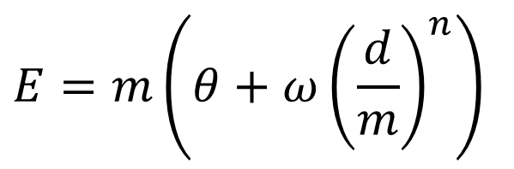
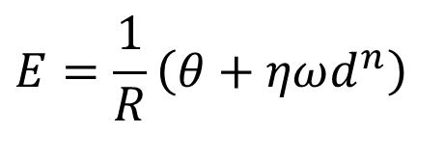
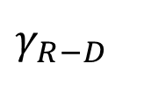

For high data rate, the transceiver on is kept on for shorter duration, therefore energy consumption will be reduced considerably. Usually high data rate is possible for shorted distance between nodes. In this case information rate R is included like,
$$E=\frac{1}{R}\left(θ+ηωd^{n}\right)$$
;Where R is the rate in bits/sec.
The traditional objective of multi hop communication is to divide the transmission distance into a number of hops, m, and to relatively conserve energy,
$$E=m\left(θ+ω{\left(\frac{d}{m}\right)}^{n}\right)$$
D
S
R
$$γ_{S−R}$$
$γ_{R−D}$
In the figure m = 2

Slide 16
1. Impact of Data Rate R
The modified energy consumption formula:
E=1/R(θ+ηωd*n)
R = data rate (bits per second)
When R increases → transmission takes less time → less energy consumed.
High data rates are easier to achieve when nodes are closer (shorter distance d).
✅ Conclusion: Increasing R reduces energy consumption, especially for short-range communications.

Slide 17


2. Multi-hop Communication Model
To save energy, instead of sending directly over a long distance d, the distance is divided into m hops (multi-hop routing).
m = number of hops (intermediate relay nodes)
Each hop covers distance d/m
Each hop still requires the fixed overhead θ.
But the distance-dependent part ωd^n is reduced since

Slide 18
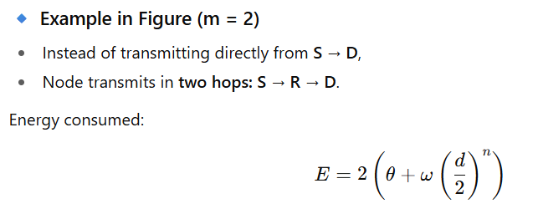
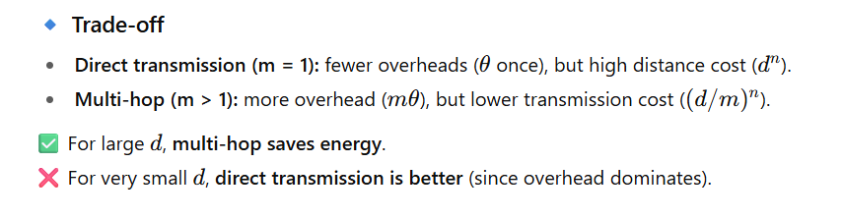

Slide 19
Clustering Protocols
An efficient Clustering Protocol ensures the creation of clusters with almost the same radius and cluster heads that are the best positioned in the cluster.
Ensure non-overlapping cluster nodes.
Links among the cluster heads are used to establish a route to the BS.

Slide 20
Clustering techniques is classified as:
Centralized
Decentralized.
Centralized clustering algorithms require each sensor node to send its individual information, such as energy level and geographical position, to the central base station.
Based on a predefined algorithm, a base station calculates the number of clusters, their sizes, and the cluster heads positions and then each node is assigned a duty.

Slide 21
Decentralized clustering techniques create clusters without the help of any centralized base station.
An energy-efficient (every node has equal chance to become cluster head so equally penalized battery) and hierarchical clustering algorithm (cluster heads are arranged in rooted tree topology) is used.
BS
The Low-Energy Adaptive Clustering Hierarchy (LEACH) algorithm and the Decentralized Energy-Efficient Cluster Propagation (DEEP) protocol are two examples of the decentralized clustering protocols and are explained next.
Hierarchical clustering, suitable for information gathering then sending to BS.

Slide 22
LEACH Clustering Protocol
It is an application-specific protocol architecture that aims to prolong network lifetime by periodic re-clustering or change of the network topology. LEACH protocol has two stages:
(a) cluster setup phase
(b) steady phase.
Each round of algorithm r, a new set of CH is selected and each CH gets a set of member nodes under its coverage.
Cluster Head
Cluster Member
After formation of clusters, cluster-members send data to cluster head and the cluster head transmit it to base station.
Base Station
Routing in LEACH

Slide 23
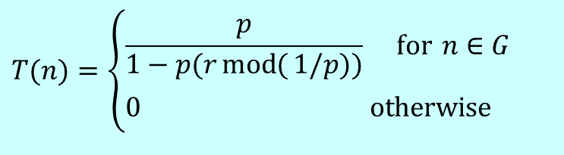
The CH selection algorithm has r = 0, 1, 2, 3,…,N -1 rounds and on each round it has a threshold number T(n) and each node generates a random number [0,1].
rand() < T(n)
Local rand() < Global T(n)
Random number is found less than T(n) for 8 blue nodes at r = 0.
$$T(n)=\left\{\begin{aligned}&\frac{p}{1−p(r\operatorname{mod}{(}1/p))} \text{for} n∈G \\ &0 \text{otherwise}\end{aligned}\right.$$
Selected CH of 1st round
where p is the ratio of the total number of cluster heads to the total number of nodes, r is the number of rounds, and G is a set of nodes that have not been chosen as cluster heads till the last rounds.

Slide 24
Random number is less than T(n) for r = 1
Selected CH of 2nd round

Slide 25
Random number is less than T(n) for r = 2
Selected CH of 3rd round

Slide 26
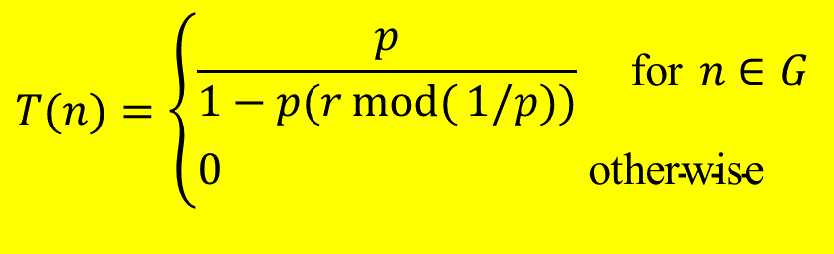
mod(33, 16) = 1, mod(12, 16) =12, mod(40, 16) = 8 etc.
Example-1
If the number of nodes N = 80 and the number of CH is 5 then find T(n) for r = 0 (1st round) and 1 (2nd round).
Here, p = 5/80 = 1/16
Taking, p = 1/16 and r = 0
T(n) = p/{1-p*(mod(r, 1/p))}
=(1/16)/{1- 1/16 *(mod(0, 16))
=(1/16)/{1- 1/16 *0)
=1/16
Taking, p = 1/16 and r = 1
T(n) = p/{1-p*(mod(r, 1/p))}
=(1/16)/{1- 1/16 *(mod(1, 16))
=(1/16)/{1- 1/16 *1)
=(1/16)/(15/16) =1/15
$$T(n)=\left\{\begin{aligned}&\frac{p}{1−p(r\operatorname{mod}{(}1/p))} \text{for} n∈G \\ &0 \text{otherwise}\end{aligned}\right.$$

Slide 27
where p is the ratio of the total number of cluster heads to the total number of nodes, r is the number of rounds (r = 0, 1, 2, 3,…,number of nodes/cluster-1) , and G is a set of nodes that have not been chosen as cluster heads till the last rounds.
r = 0:15;
p = 1/16;
Tn =p./(1-p*(mod(r,1/p)));
plot(r,Tn, 'b>-')
xlabel('r')
ylabel('T(n)')
grid on
The threshold number T(n) increases with round r indicates the probability of the rest of the nodes will have more chance to become CH.
r = 0 1 2 3 4 5 6 7 8 9 10 11 12 13 14 15
T_{n} = 0.0625 0.0667 0.0714 0.0769 0.0833 0.0909 0.1 0.1111 0.125 0.1429 0.1667 0.2 0.25 0.3333 0.5 1

Slide 28
Setup phase algorithm
Start round r = 0
All the sensing node (SN) has probability of becoming cluster head (CH).
For round r, after node is elected as CH, it will start broadcasting ‘Hello’ message to nodes in a cluster.
Energy used to broadcast message is equal for all the cluster heads.
Initially, all the nodes those are not CH are supposed to keep their receiver ON to receive broadcasted message.
For round r, non-cluster head nodes (member nodes) will choose the cluster based on minimum energy criteria required to transmit/receive messages/data i.e. it selects the nearest CH.
Random selection of CH will be done if more number of nodes declare themselves as CH.

Slide 29
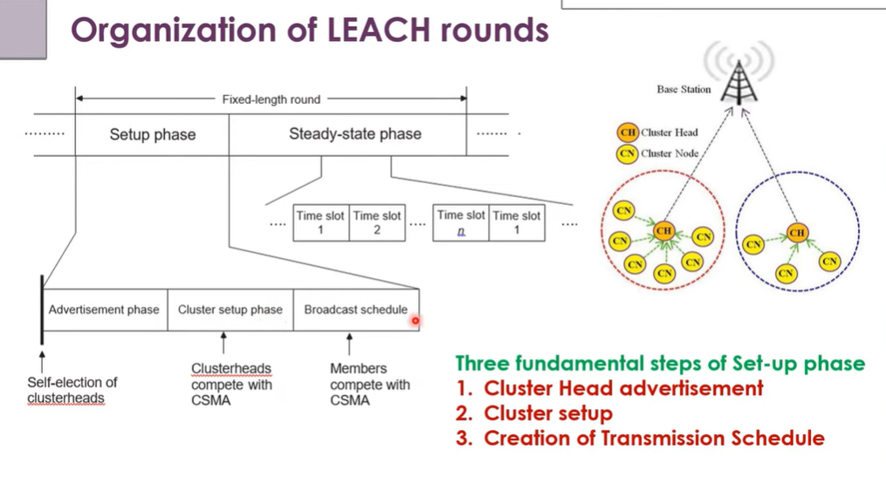
CHs broadcast their status to nearby nodes using CSMA (Carrier Sense Multiple Access).

Slide 30
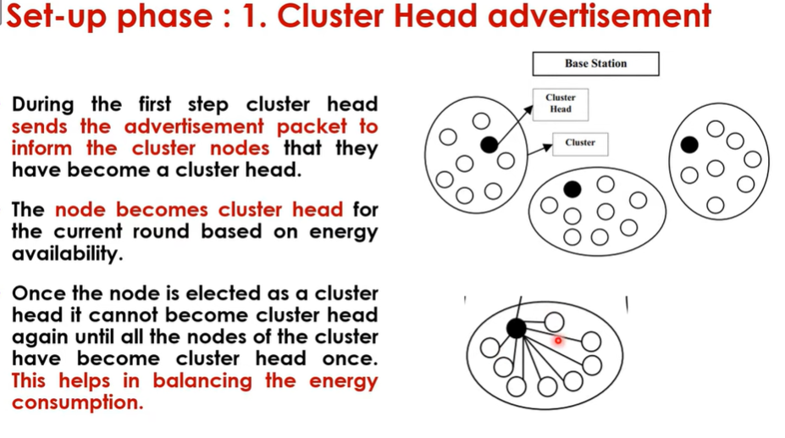

Slide 31
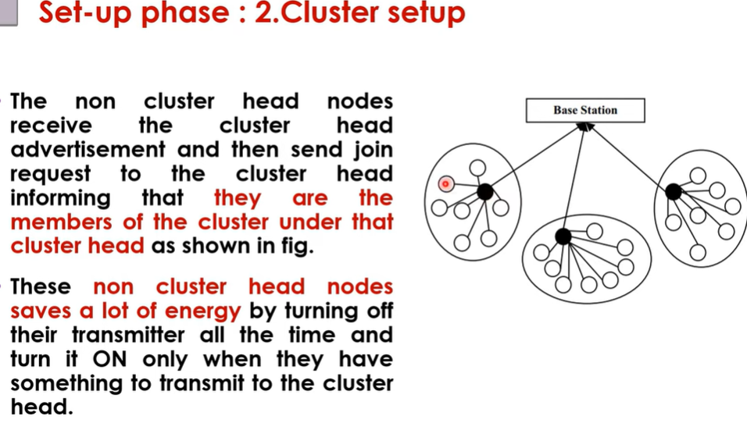

Slide 32
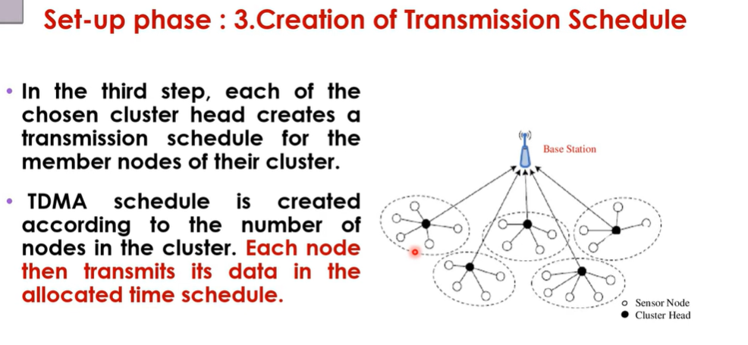

Slide 33
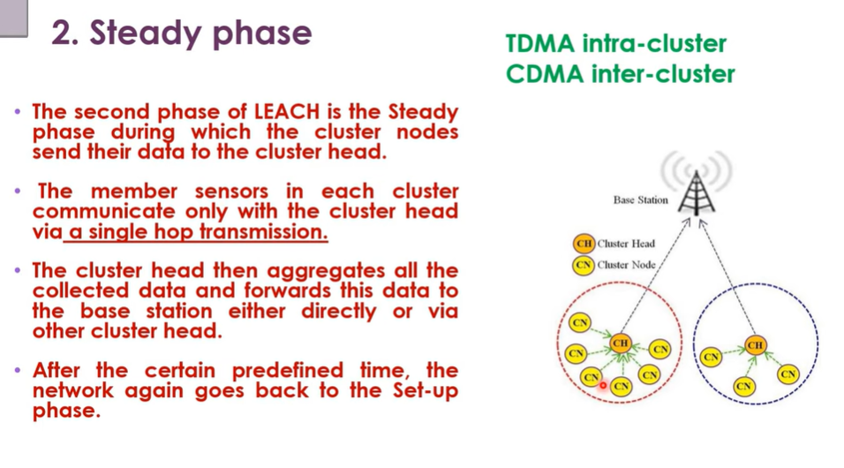

Slide 34
Steady state phase Algorithm
Cluster Member Notification
Each non-cluster head (non-CH) node sends a message to its cluster head (CH) to announce its membership.
The CH compiles a list of member nodes in its cluster.
TDMA Scheduling by CH
The CH creates a TDMA schedule and assigns time slots to each member node.
This schedule is broadcasted to all cluster members.
Energy-Saving Mechanism
Non-CH nodes only switch on their transmitters during their allocated time slots.
At all other times, they keep their radio turned off, thus conserving energy (similar to GSM TDMA sleep cycles).

Slide 35
Steady state phase Algorithm
4. Intra-Cluster Communication
Each non-CH node transmits its sensed data to the CH in its scheduled slot.
5. Data Aggregation at CH
The CH receives and aggregates data from all cluster members (e.g., removing redundancy, computing averages).
6. Transmission to Base Station (BS)
Finally, the CH transmits the aggregated data to the BS (sink), usually via a longer-range communication link.

Slide 36
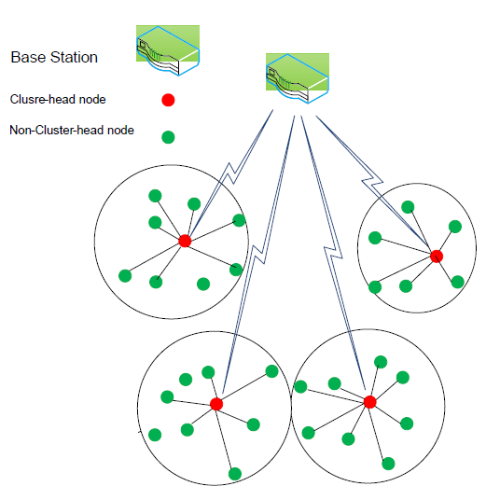
Limitation of LEACH algorithm
In cluster setup phase the position and energy of each node is not considered.
Cluster head uses single hop to communicate with the BS which may cause more energy consumption.
Random rotation of cluster head and the network constantly update the cluster result in excessive energy consumption.
Fig. 1. LEACH

Slide 37
2. DEEP Clustering Protocol
The Decentralized Energy-Efficient Cluster Propagation (DEEP) protocol that establishes clusters with uniformly distributed CHs and radius of each cluster is almost same.
The algorithm deals with control signals and protocol parameters like:
Control signals:
cluster-head declaration signal (coverage of cluster)
cluster-head exploration signal (location of other CH)
Membership search signal with control parameters:
declaration range d_{r} and received energy is greater than E_{rc}
exploration range (d_{r1}, d_{r2}) and received energy E_{rc1} > E_{r} > E_{rc2}
minimum number of members (m_{n}) to sustain a cluster.
d_{r2}
E_{rc2}
d_{r1}
E_{rc1}
d_{r}
CH
E_{r}

Slide 38
Cluster Formation Using Control Signals & Protocol Parameters
1. Cluster-Head (CH) Declaration Phase
A node that decides (or is elected) to be a CH broadcasts a Cluster-Head Declaration Signal.
This signal covers a range called the declaration range (dr).
A non-CH node becomes a member of this cluster if the received signal energy (Er) ≥ Erc (the declaration threshold).
2. Cluster-Head Exploration Phase
Each CH transmits a Cluster-Head Exploration Signal to identify other CHs in its neighborhood.
Exploration is performed in a distance range (dr1, dr2), i.e., beyond the direct declaration zone but within sensing range.
Neighboring CHs compare the received signal energy:
If Erc1 > Er > Erc2, the CH records the presence of the other CH.
This prevents overlapping clusters and helps maintain balance in cluster distribution.

Slide 39
3. Membership Search & Validation Phase
Each CH checks how many nodes responded to its declaration.
If the minimum number of members (mn) is satisfied → the cluster is sustained.
If not →
The CH may withdraw its declaration.
Its members return to the pool and search for other CHs to join.
Key Parameters:
dr → Cluster-head declaration range.
Erc → Threshold received energy for cluster membership.
(dr1, dr2) → Exploration range for detecting neighboring CHs.
Erc1, Erc2 → Energy thresholds for exploration.
mn → Minimum required members per cluster.

Slide 40
DEEP algorithm begins with an initial CH which starts the cluster set-up phase by propagating cluster-head declaration signals within the range of d_{r}. The sensor nodes that receive the declaration signal (with energy greater than E_{rc}) accept the corresponding CH as a leader.
d_{r2}
d_{r1}
d_{r}
CH
Region of cluster-head
declaration

Slide 41
Now, the initial CH transmits the cluster-head exploration signal. Only nodes that have never played the role of a cluster head and the received signal satisfies the inequality E_{rc1} > E_{r} > E_{rc2} i.e. nodes at a distance d_{r2} < d_{r} < d_{r1} (meaning the node is not too close to the initial CH, and not too far either.)are eligible to be new cluster head.
Note that E_{rc1} and E_{rc2} are fixed protocol parameters that can be pre calculated and stored in the sensor-node memory, using the following formula:
d_{r2}
d_{r1}
d_{r}
CH
CH
Received Energy
Path-loss
Transmit power
Region of cluster-head Exploration
(region between two concentric circles)

Slide 42
After a new cluster-head candidate is assigned, it sends a declaration and exploration signal like before.
If two cluster-head candidates can hear each other's declaration signal, (they are too close to each other to be considered cluster-head candidates) one of them is eliminated through a negotiation phase.
A member node that receives a declaration signal from more than one candidate chooses the candidate whose associated signal is received with a higher power.
Nodes that have already been chosen as cluster head or member ignore the cluster-head exploration or declaration signals.
d_{r2}
d_{r1}
d_{r}
CH
CH

Slide 43
Finally, this advertisement (cluster-head exploration or declaration signals) process terminates automatically when all the nodes in the sensing field belong to a cluster.
At this point, the algorithm might have produced some clusters have members less that m_{n}. Those clusters are dissolved, and all its members, including its cluster head, initiate a membership-search signal.

Slide 44
Begin DEEP Clustering Algorithm
Initial cluster head finds cluster members by sending ‘cluster-head declaration’.
Initial cluster head finds new cluster-head candidates by sending ‘cluster-head exploration signal’.
Repeat: Cluster-head candidates that are placed on the (d_{r1}, d_{r2}) ring find cluster members.
Nodes that receive more than one cluster-head declaration choose the closest cluster head, based on the received signal energy.
Cluster-head candidates that receive a cluster-head declaration signal negotiate with the sender, and one of them gets eliminated.
Confirmed cluster heads send "cluster-head exploration" signals to find new cluster-head candidates(Go to step 4).
Finalize: If the number of members in a cluster is less than m_{n}, all the members find new clusters by sending the membership-search signal.
At the end, a node that has not received any control signal sends the membership-search signal.

Slide 45
a. Intracluster Routing Protocols
A routing algorithm within a cluster can be either direct or multi-hop.
In a direct routing algorithm, the cluster head as the destination for all cluster nodes is located in the center of the cluster, so all nodes can communicate with the cluster head directly, as shown in Figure below.
15
3
13
5
Too far from cluster head
1
16
2
Low-Energy Node
14
3
Direct routing
17

Slide 46
The number associated with each node indicates a normalized value of the remaining energy in that node.
Note that in this figure, two nodes cannot reach the destination, as they are located far from it.
15
3
13
5
Too far from cluster head
1
16
2
Low-Energy Node
14
3
17

Slide 47
In a multi-hop routing algorithm, a node can face multiple hops in order to reach the destination. Figure below shows two paths from a node (node 5 is the source node) to a cluster-head node. One path involves the shortest distance in terms of hop counts; the other one uses the highest-energy route. The challenge here is to find the best path that suits the rapid and secure deployment of data.
15
Best energy path
13
5
1
16
4
14
3
Shortest path
2
3
16
2
Low energy node

Slide 48
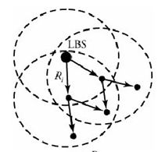
b. Intercluster Routing Protocols
Intercluster protocols are not typically different from the multihop ones for intradomain cases. Interdomain protocols are available for
Intercluster energy conscious routing (ICR)
Energy-aware routing (EAR)
Direct diffusion
Intercluster Energy-Conscious Routing (ICR)
ICR is a destination-initiated reactive routing protocol. This means that a destination, local base station (LBS), initiates an explicit route-discovery phase, which includes the propagation of an interest signal that floods throughout the network and establishes energy-efficient routes.
Figure 7. LBS starts route discovery by
generating interest signals

Slide 49
Intercluster Energy-Conscious Routing (ICR)
Nature: Destination-initiated, reactive routing protocol.
How it works:
The destination (Local Base Station – LBS) initiates the route discovery.
The LBS sends an interest signal.
This signal floods through the network, helping nodes discover energy-efficient routes.
Goal: Ensure that routes between clusters are energy-efficient, extending the network’s lifetime.
Figure Explanation (Figure 7)
LBS (Local Base Station): The central destination node.
It generates interest signals that spread across the network.
Other nodes receive the signal and participate in building efficient paths back to the LBS.
The dotted circles likely represent clusters.
The arrows indicate route discovery and signal flooding.

Slide 50
Intercluster Energy-Conscious Routing (ICR)
Type: Destination-initiated reactive protocol (not proactive → no periodic route maintenance).
Key Idea: The Local Base Station (LBS) starts route discovery, instead of source nodes.
Process
Route Discovery Initiation
The LBS generates an interest signal (like a query or request for data).
This signal is flooded across the network.
Interest Signal Propagation
Each node/CH that receives the signal forwards it to neighbors.
While forwarding, nodes also record energy metrics (residual energy, link cost).
Path Establishment
Multiple possible paths from LBS to sensor nodes are discovered.
Among them, energy-efficient routes (minimizing total energy consumption) are selected.
Data Transmission
Sensor data follows the selected path back to the LBS.
Since paths are chosen based on energy-awareness, nodes avoid quick depletion.

Slide 51
Why Intercluster Protocols Are Needed
Direct communication from each CH to the BS is costly (long distance → high energy).
Instead, CHs cooperate and forward data hop-by-hop through other CHs to the BS.
Efficient routing ensures:
Reduced energy consumption
Prolonged network lifetime
Balanced energy usage across clusters

Slide 52
Computational Intelligence in WSN

Slide 53
Computational Intelligence in WSN
Computational Intelligence (CI) is a set of nature-inspired, adaptive, and heuristic approaches used to solve complex optimization and decision-making problems. In Wireless Sensor Networks (WSN), CI is very useful because WSNs face challenges like:
Limited energy (battery power).
Limited bandwidth and processing power.
Harsh and dynamic environments.
Scalability (hundreds or thousands of nodes).
Need for self-organization and autonomous operation.
Major CI Techniques in WSN
1. Genetic Algorithms (GA)
2. Swarm Intelligence (SI)
3. Fuzzy Logic
4. Neural Networks (NN)
5. Evolutionary Algorithms (EA)
6. Reinforcement Learning (RL)

Slide 54
Applications of CI in WSN
1. Cluster Head (CH) Selection
Genetic Algorithm (GA):
Particle Swarm Optimization (PSO):
Fuzzy Logic
2. Routing Optimization
Ant Colony Optimization (ACO)
Neural Networks
Reinforcement Learning (RL)
3. Data Aggregation & Fusion
Fuzzy Logic
Neural Networks
Swarm Intelligence
4. Fault Tolerance & Security
Detect faulty nodes using machine learning models.
Secure routing with game theory + CI approaches.
Adaptive re-clustering when nodes fail.
🔹 Benefits of CI in WSN
✅ Better energy efficiency (longer network lifetime) ✅ Improved scalability & adaptability ✅ Enhanced robustness under uncertainty ✅ Smarter, autonomous decision-making

Slide 55
Genetic Algorithm (GA) Basics
A Genetic Algorithm is an evolutionary optimization method inspired by natural selection.
It works by evolving a population of possible solutions over generations until an optimal (or near-optimal) solution is found.
Step-by-Step GA for CH Selection
Step 1: Encoding (Chromosome Representation)
Suppose we have 10 nodes (N1–N10).
We want to choose some of them as cluster heads (CHs).
Chromosome is a binary string of length 10:
1 = node is a CH
0 = node is a normal node
Step 2: Initial Population
Generate random chromosomes (possible CH sets). Example:
Chromosome | CHs (1 = selected)
1010001000 | N1, N3, N7
0101000100 | N2, N4, N8
1000100010 | N1, N5, N9
0010010101 | N3, N6, N8, N10

Slide 56

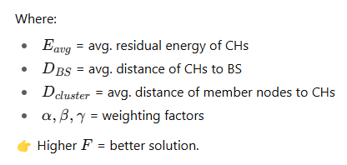
Step 3: Fitness Function
We need to evaluate how good each chromosome is. Typical fitness function in CH selection considers:
Residual Energy (higher energy → better CH).
Distance to Base Station (BS) (closer CHs → less energy cost).
Average Intra-Cluster Distance (shorter → efficient communication).
Example Fitness Formula:

Slide 57
Step 4: Selection
Use Roulette Wheel Selection or Tournament Selection.
Chromosomes with higher fitness are more likely to reproduce.
Step 5: Crossover
Pick two parent chromosomes and swap parts to create offspring.
Example (single-point crossover at position 5):
Parent1: 10100 | 01000 Parent2: 01010 | 00100 Offspring1: 10100 | 00100 Offspring2: 01010 | 01000
Step 6: Mutation
Flip a few random bits to maintain diversity.
Example: Original Offspring1: 1010000100 After mutation (bit 7 flips): 1010001100

Slide 58
Step 7: Replacement & Evolution
Replace weaker chromosomes with new offspring.
Repeat fitness → selection → crossover → mutation for many generations (e.g., 50–100)
Step 8: Final Solution
After evolution, the best chromosome is selected.
Example best chromosome:
N2, N5, N7 are chosen as Cluster Heads. These CHs minimize energy usage and maximize coverage.

Slide 59
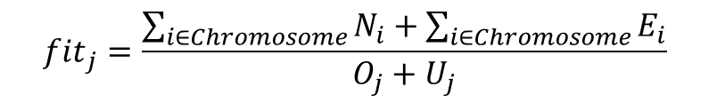
GA in WSN to select a node as CH
0 | 0 | 1 | 0 | 1 | 0 | 0 | 0 | 1 | 0
Ordinary node (yellow in figure)
Cluster Heads Blue color in the figure
Each gene of the chromosome is a sensor node.
N_{i}→ Number of nodes within radius r for CH i
E_{i} → Remaining energy of CH i
O_{j} → Number of overlapped node under jth chromosome
U_{j} → Number of nodes outside the cover for the
chromone (in the figure U_{j} = 2)
The fitness function of jth Chromosome,
$${fit}_{j}=\frac{\sum_{i∈Chromosome}{N_{i}}+\sum_{i∈Chromosome}{E_{i}}}{O_{j}+U_{j}}$$
Crossover and mutation will change the number and location of CHs hence fitness function.

Slide 60
FIS in selection of CHs
Each node of the WSN is associated with FIS or Fuzzy Logic Controller (FLC). FIS uses four linguistic variables:
Energy = {very low, low, medium, high, very high}→ remaining battery energy of a node
Density = {low, medium, high} → Number of adjacent nodes i.e. within radius r or density of adjacent nodes.
Distance = {very small, small, medium, long, very long} → distance between the node and base station
Output ={very small, small, medium, long, very long} → grade of MF is related to become a node CH
… … …
… … …
Rule-1
Rule-2
Rule-3
… … …
… … …
Rule-n
Input
Output
Fuzzification
Inference
Defuzzification

Slide 61
medium
Very high
Very low
low
high
μ(Energy)
Energy
Energy = {very low, low, medium, high, very high}
Very low
high
medium
μ(density)
Density
Density = {low, medium, high}

Slide 62
medium
Very long
Very small
small
long
μ(Distance)
Distance
Distance = {very small, small, medium, long, very long}
medium
Very high
Very small
small
high
μ(output)
output
Output ={very small, small, medium, high, very high}

Slide 63
Fuzzy rules:
If (distance is near) and (density is low) and (energy is very low) then (output is vey high)
If (distance is near) and (density is low) and (energy is low) then (output is vey high)
If (distance is near) and (density is low) and (energy is medium) then (output is medium)
If (distance is near) and (density is high) and (energy is high) then (output is small)
If (distance is near) and (density is high) and (energy is very high) then (output is very small)
… … …
… … …
… … …
etc.
Based on FIS output, a timer is activated on each node and starts countdown. When timer reaches zero the node sends its message to the BS as the candidate of CH. Better node send its message quicker and avoid collision with other nodes. The BS selects the better candidate (based on receiving instant of message) nodes as the CH.
Next, the genetic algorithm of previous model can be applied to select the appropriate CHs (CHs of appropriate location) in real network so that minimum energy (uniform cluster with shorted mean length between members and CH of a cluster) with be used for communication.

Slide 64
Fuzzy Node Localization in WSN
Three types of nodes are deployed in WSN: (i) Anchor nodes are equipped with GPS device or location is known during deployment time (ii) normal node are randomly deployed in sensing field and their location is determined with help of anchor nodes (iii) base station, located far way form sensing filed and collect information from sensing nodes.
The maximum communication range is r_{c} and sensing range is r_{s}, where r_{c} < r_{s}.
Fuzzy rules:
Rule-1: If RSS is Very strong then distance is Very near
Rule-2: If RSS is Strong then distance is Near
Rule-3: If RSS is Moderate then distance is Moderate
Rule-4: If RSS is Weak then distance is Far
Rule-5: If RSS is Very Weak then distance is Very Far
RSS → Received signal strength
Normal node
Anchor nodes
Base station

Slide 65
Moderate
Very Weak
Very strong
Strong
Weak
Membership function of input variable
μ(RSS)
RSS
Moderate
Very far
Very near
Near
Far
μ(r)
Membership function of output variable
r

Slide 66
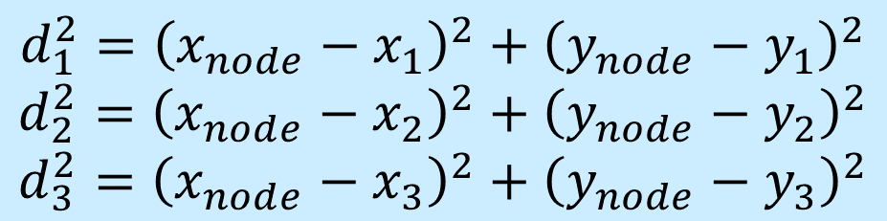
(x₁, y₁)
$$d_{1}^{2}={\left(x_{node}−x_{1}\right)}^{2}+{\left(y_{node}−y_{1}\right)}^{2}$$
$$d_{2}^{2}={\left(x_{node}−x_{2}\right)}^{2}+{\left(y_{node}−y_{2}\right)}^{2}$$
$$d_{3}^{2}={\left(x_{node}−x_{3}\right)}^{2}+{\left(y_{node}−y_{3}\right)}^{2}$$
RSS₁: d₁
(x_{node}, y_{node})
RSS₂: d₂
RSS₃: d₃
(x₃, y₃)
(x₂, y₂)
Solving above equations we can find (x_{node}, y_{node})

Slide 67
GA in shortest link selection
S | A | G | I | D
S | B | C | K | F | J | D
H
S | B | E | G | A | H | D
S
A
G
Mutation
B
I
D
Crossover
E
C
J
S | B | E | I | D
K
S | A | H | D
F
S | B | E | G | I | D
Here chromosome is composed of nodes forming source to destination link.

Slide 68
References
Sethu Lakshmi Pa and Jibukumar M G, ‘Performance Analysis of SWIPT in Multi-hop Wireless Sensor Networks,’ Third International Conference on Computing and Network Communications (CoCoNet’19), pp.2157–2166, Procedia Computer Science 171 (2020)
Zhansheng Chen and Hong Shen, ‘A grid-based reliable multi-hop routing protocol for energy-efficient wireless sensor networks,’ International Journal of Distributed Sensor Networks, pp.1-17, Vol. 14(3), 2018
Liao Wenxing, Wu Muqing, Zhao Min, Li Peizhe and Li Tianze, ‘Hop count limitation analysis in wireless multi-hop networks,’ International Journal of Distributed Sensor Networks, Vol. 13(1), pp.1-12, 2017
G. Guo, G. Sun, S. Bin and F. Shao, ‘Design and Analysis of Field Telemedicine Information Communication Protocol Based on Wireless Sensor Network,’ in IEEE Access, vol. 7, pp. 50630-50635, 2019
M. Deb and S. Roy, ‘Harvested Profile Aware Multi hop Routing Protocol for Wireless Sensor Network,’ 2018 Fifth International Conference on Emerging Applications of Information Technology (EAIT), 2018, pp. 1-4, 12-13 January 2018, Kolkata, India
Nader F. Mir, ‘Computer and Communication Networks,’ Pearson Education, 2009
T. Tatarnikova and F. Bimbetov, ‘Bee Swarm Algorithm for Selecting Heads of Wireless Sensor Network Clusters,’ 2022 11th Mediterranean Conference on Embedded Computing (MECO), 2022, pp. 1-4, 07-10 June 2022, Budva, Montenegro
N. N. Reddy and S. C, ‘Energy Efficient Clustering Hierarchy in Wireless Sensor Network using Dynamic Clustering Approach ILEACH-ACHH Protocol Compared with LEACH-ACHH Protocol,’ 2022 2nd International Conference on Innovative Practices in Technology and Management (ICIPTM), 2022, pp. 535-541, 23-25 February 2022, Gautam Buddha Nagar, India

Slide 69
Thank You

